Slide 1

Distracted Driver Detection with Convolution Neural Network
Name: Liu, Shijie
Professor: Liu, Xinlian
Date: 11/19/2020
Computer Science Department
Hood College of Frederick Maryland

Slide 2
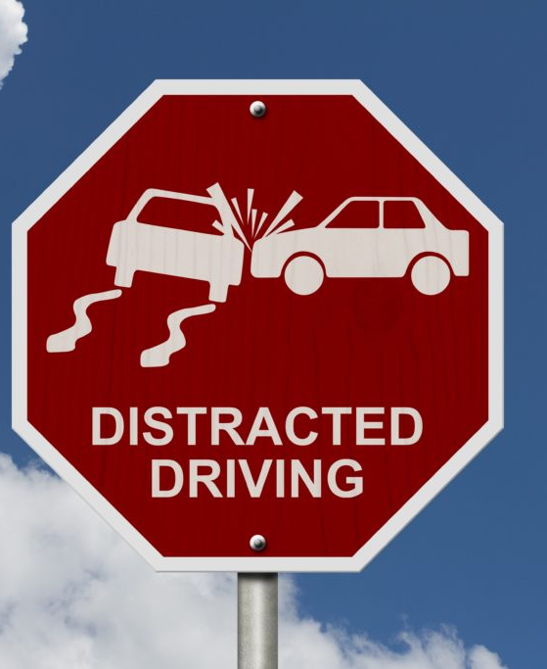
Project analysis slide 2
Project Outline
Project Overview
PROJECT
Project Implementation
Lessons Learned & Future Work

Slide 3
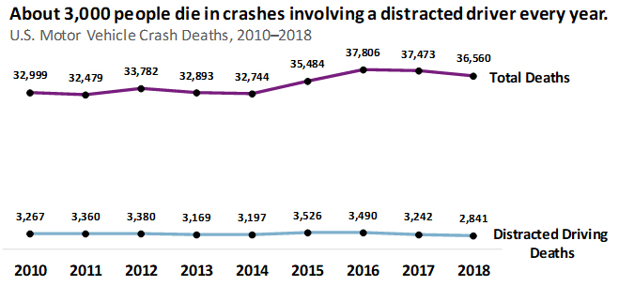
Project analysis slide 2
Project Overview
Background
Visual Distraction: Eyes off the road
Manual Distraction: Hands off the wheel
Cognitive Distraction: Minds off the driving
Objective
A Convolution Neural Network that can detect distracted driver from a 2D dash-cam image.

Slide 4
Project analysis slide 2
Implementation
Dataset
Dataset Collection
Architectures
Convolution Neural Network from Scratch
Dataset Exploration
Dataset Spilt
Dataset pre-processing
Transfer learning with VGG-19 via fine-tuning
Evaluation
Loss
Accuracy
Confusion Matrix
Techniques
Image Data Generator
Transfer Learning
Image Data Augmentation
Dropout

Slide 5
Project analysis slide 4
Data Description
Source
State Farm Distracted Driver Detection dataset on Kaggle
https://www.kaggle.com/c/state-farm-distracted-driver-detection/data
Description
|── imgs
|── train → Labeled 22,424 files with the resolution of 480x640
|── c0 → Class id, see the class id mapping on the right
|── img_103.jpg
|── ......
|── img_352.jpg
|── c1
|── img_421.jpg
|── ......
|── img_782.jpg
|── c2
|── ......
|── c9
|── test → Unlabeled 79,726 files with the resolution of 480x640
|── img_1028.jpg
|── img_1029.jpg
|── ......
|── driver_imgs_list.csv → Captures filename, subject id, class id
|── sample_submission.csv → Sample format for Kaggle submission, NOT APPLICABE
Distraction Classes:
c0: safe driving
c1: texting - right
c2: talking on the phone - right
c3: texting - left
c4: talking on the phone - left
c5: operating the radio
c6: drinking
c7: reaching behind
c8: hair and makeup
c9: talking to passenger

Slide 6
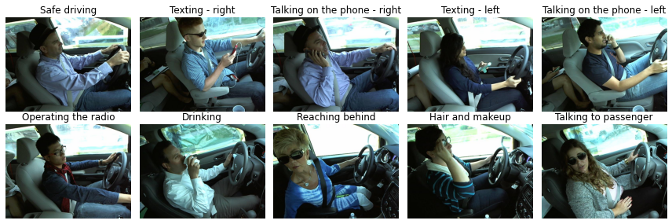
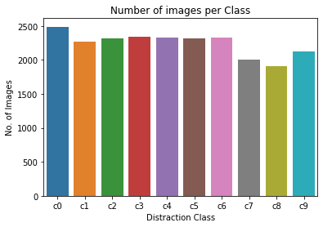
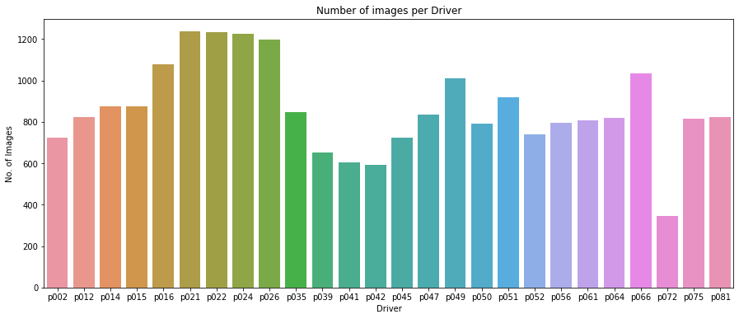
Project analysis slide 6
Data Exploration
Sample image per distraction class

Slide 7
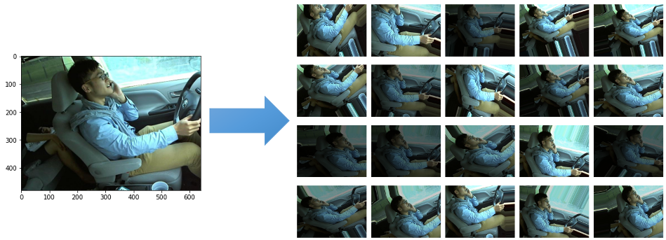
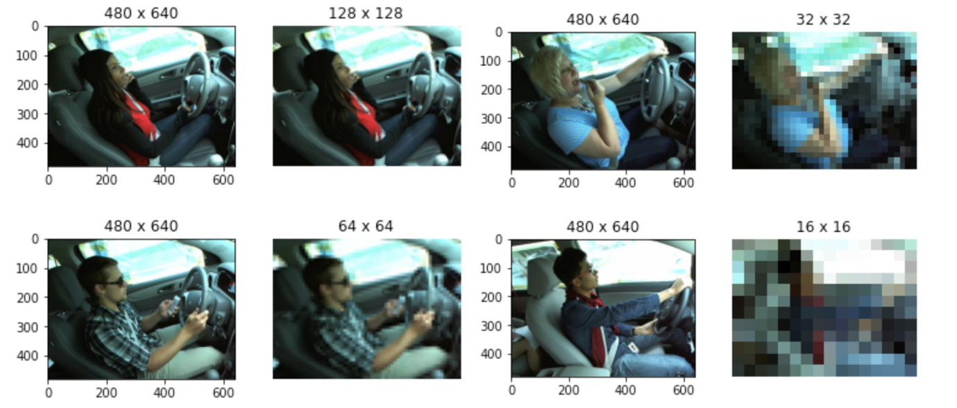
Project analysis slide 7
Data Pre-Processing
Image Augmentation
Generates more data from existing data
Exposes more aspects of same data
Supports random on-the-fly transformation
Image Resizing
Reduces memory load by reducing the image size
Allows the batch size to be increased to speed up model training time
Keeps the original aspect ratio and preserves the feature information

Slide 8
Project analysis slide 7
Architecture
Convolution Neural Network from Scratch
Three common layers are used, convolution, pooling, and fully connected
Input layers accepts 64x64x3 input (RGB images)
Three convolution layers, with various number of filters. E.g. 32, 64, and 128; All convolution layers use relu activation function and 5x5 stride.
Each convolution layer has a following max pooling layer, which uses 2x2 pooling window.
Two fully connected dense layers are following after flattening out, the last layer has 10 as number of output, which corresponds to number of classes to classify.
8x8x128
Dropout
64x64x3
64x64x32
32x32x64
256
16x16x128
10
Input layer
Convolution layer
Max Pooling layer
Fully connected dense layer

Slide 9
Project analysis slide 7
Architecture
Fine-tuned VGG-19 Convolution Neural Network
2x2x512
VGG network architecture includes two variants, VGG-16 and VGG-19.
Original VGG-19 takes 224x224x3 input shape
Includes 16 convolution layers(3x3 stride), 5 max pooling layers(2x2 pooling window), and 3 fully connected layers(first two layers have 4096 outputs, while the last has 1000 outputs)
Dropout
64x64x3
64x64x64
32x32x128
256
16x16x256
10
8x8x512
4x4x512
Input layer
Convolution layer
Fine-tuning:
Max Pooling layer
Fully connected dense layer
Replace three fully connected dense layers with two, which use 256 and 10 as output
Keep convolution and pooling layers as convnet base, but later layers will be kept trainable.

Slide 10
Project analysis slide 7
Techniques
ImageDataGenerator
Supports loading data via batches, which overcomes the challenge with limited memory.
Offers an easy way to load dataset, categorizing classes and train/validation spilt.
Supports image pre-processing, such as rescaling, resizing, and image augmentation.
train_datagen = ImageDataGenerator(
rescale=1.0 / 255,
rotation_range=20,
width_shift_range=0.2,
height_shift_range=0.2,
brightness_range=[0.4, 1.2],
shear_range=0.2,
zoom_range=0.3,
validation_split=0.2)
train_generator = train_datagen.flow_from_directory(
TRAIN_DIR,
target_size=(INPUT_HEIGHT, INPUT_WIDTH),
classes=None,
class_mode="categorical",
batch_size=BATCH_SIZE,
shuffle=True,
subset="training")
Transfer Learning
# load the convnet base
conv_base = VGG19(
weights="imagenet",
include_top=False,
input_shape=(INPUT_HEIGHT, INPUT_WIDTH, 3))
x = conv_base.output
# add flatten, dropout, dense, etc
predictions=layers.Dense(10, activation="softmax")(x)
model=models.Model(inputs=conv_base.input,
outputs=predictions)
# freeze the training
for layer in model.layers[:10]:
layer.trainable = False
model.compile(…)
model.fit(…)
A common and highly effective approach for deep learning with small image dataset.
Pre-trained models were trained with large scale dataset that local features for generic objects have been learned. E.g. ImageNet, 1000 classes trained from 1.4 million labeled images.
Offers two approaches, feature extraction(Add new classifier on top of convolutional base) and fine-tuning(Replace fully connected layers and optionally fine-tune all or part of convolutional base via backpropagation).
Dropout
One of the most effective and most commonly used regularization techniques for neural networks, which is an efficient way of reducing overfitting by randomly drooping out some neurons during training phase.
model.add(layers.Dropout(0.3))

Slide 11
Project analysis slide 7
Model Evaluation
D: Dropout
BN: Batch Normalization
DA: Data Augmentation
LR: Learning Rate
LF: Layers frozen
Convolution Neural Network from Scratch
 | Training |  | Validation |  | Test
 | Loss | Accuracy | Loss | Accuracy | Loss | Accuracy
Base | 0.022 | 99.33% | 0.085 | 97.83% | 2.69 | 66.00%
Base + D(0.3) | 0.009 | 99.72% | 0.022 | 99.46% | 2.85 | 62.99%
Base + D(0.3) + BN | 0.051 | 99.81% | 0.041 | 99.62% | 0.903 | 75.00%
Base + D(0.3) + BN + DA | 0.207 | 94.98% | 0.422 | 87.03% | 0.664 | 81.00%
Base + D(0.2) + BN + DA | 0.148 | 96.50% | 0.221 | 94.11% | 0.858 | 75.00%
Base + D(0.4) + BN + DA | 0.343 | 91.52% | 0.487 | 85.69% | 0.762 | 74.00%
Base + D(0.3) + BN + DA + LR(0.01) | 0.087 | 97.55% | 0.074 | 97.88% | 0.683 | 84.00%
Base + D(0.3) + BN + DA + LR(0.001) | 0.199 | 95.12% | 0.32 | 90.02% | 0.804 | 75.00%
Base + D(0.3) + BN + DA + LR(0.0001) | 0.59 | 88.65% | 0.55 | 89.49% | 0.96 | 70.00%
Base + BN + DA + LR(0.01) | 0.0626 | 98.32% | 0.078 | 97.63% | 0.792 | 78.00%
Experimented dropout, batch normalization, data augmentation, and learning rate.
0.3 seems to be the best choice for dropout rate.
0.01 seems to be the best choice for learning rate.
Fine-tuned VGG-19 Convolution Neural Network
 | Training |  | Validation |  | Test
 | Loss | Accuracy | Loss | Accuracy | Loss | Accuracy
Base | 0.013 | 99.88% | 0.083 | 97.46% | 2.42 | 54.00%
Base + D(0.3) | 0.092 | 97.11% | 0.071 | 98.12% | 2.11 | 46.99%
Base + D(0.3) + DA | 1.23 | 56.95% | 1.072 | 63.59% | 1.536 | 46.00%
Base + D(0.2) + DA | 1.186 | 58.52% | 1.073 | 63.39% | 1.735 | 39.00%
Base + D(0.4) + DA | 1.378 | 51.39% | 1.207 | 59.29% | 1.546 | 48.00%
Base + D(0.3) + DA + LR(0.01) | 1.807 | 33.25% | 1.745 | 35.07% | 1.678 | 30.00%
Base + D(0.3) + DA + LR(0.001) | 1.303 | 53.69% | 1.13 | 61.92% | 1.66 | 44.00%
Base + D(0.3) + DA + LR(0.0001) | 1.613 | 43.54% | 1.514 | 47.92% | 1.467 | 47.00%
Base + D(0.3) + DA + LR(0.0001) + LF(15) | 0.123 | 96.03% | 0.157 | 95.02% | 0.635 | 82.00%
Base + D(0.3) + DA + LR(0.00001) + LF(15) | 0.177 | 94.33% | 0.207 | 93.06% | 0.9843 | 70.00%
Base + D(0.3) + DA + LR(0.0001) + LF(10) | 0.092 | 97.32% | 0.115 | 96.43% | 0.623 | 87.00%
Experimented dropout, data augmentation, learning rate, and number of layers for re-training.
0.3 dropout rate was kept for consistency.
0.0001 seems to be the best choice for learning rate.
More layers to be retrained leads to better result.

Slide 12
Project analysis slide 7
Model Evaluation
D: Dropout
BN: Batch Normalization
DA: Data Augmentation
LR: Learning Rate
LF: Layers frozen
Convolution Neural Network from Scratch
 | Training |  | Validation |  | Test
 | Loss | Accuracy | Loss | Accuracy | Loss | Accuracy
Base | 0.022 | 99.33% | 0.085 | 97.83% | 2.69 | 66.00%
Base + D(0.3) | 0.009 | 99.72% | 0.022 | 99.46% | 2.85 | 62.99%
Base + D(0.3) + BN | 0.051 | 99.81% | 0.041 | 99.62% | 0.903 | 75.00%
Base + D(0.3) + BN + DA | 0.207 | 94.98% | 0.422 | 87.03% | 0.664 | 81.00%
Base + D(0.2) + BN + DA | 0.148 | 96.50% | 0.221 | 94.11% | 0.858 | 75.00%
Base + D(0.4) + BN + DA | 0.343 | 91.52% | 0.487 | 85.69% | 0.762 | 74.00%
Base + D(0.3) + BN + DA + LR(0.01) | 0.087 | 97.55% | 0.074 | 97.88% | 0.683 | 84.00%
Base + D(0.3) + BN + DA + LR(0.001) | 0.199 | 95.12% | 0.32 | 90.02% | 0.804 | 75.00%
Base + D(0.3) + BN + DA + LR(0.0001) | 0.59 | 88.65% | 0.55 | 89.49% | 0.96 | 70.00%
Base + BN + DA + LR(0.01) | 0.0626 | 98.32% | 0.078 | 97.63% | 0.792 | 78.00%
Experimented dropout, batch normalization, data augmentation, and learning rate.
0.3 seems to be the best choice for dropout rate.
0.01 seems to be the best choice for learning rate.
Fine-tuned VGG-19 Convolution Neural Network
 | Training |  | Validation |  | Test
 | Loss | Accuracy | Loss | Accuracy | Loss | Accuracy
Base | 0.013 | 99.88% | 0.083 | 97.46% | 2.42 | 54.00%
Base + D(0.3) | 0.092 | 97.11% | 0.071 | 98.12% | 2.11 | 46.99%
Base + D(0.3) + DA | 1.23 | 56.95% | 1.072 | 63.59% | 1.536 | 46.00%
Base + D(0.2) + DA | 1.186 | 58.52% | 1.073 | 63.39% | 1.735 | 39.00%
Base + D(0.4) + DA | 1.378 | 51.39% | 1.207 | 59.29% | 1.546 | 48.00%
Base + D(0.3) + DA + LR(0.01) | 1.807 | 33.25% | 1.745 | 35.07% | 1.678 | 30.00%
Base + D(0.3) + DA + LR(0.001) | 1.303 | 53.69% | 1.13 | 61.92% | 1.66 | 44.00%
Base + D(0.3) + DA + LR(0.0001) | 1.613 | 43.54% | 1.514 | 47.92% | 1.467 | 47.00%
Base + D(0.3) + DA + LR(0.0001) + LF(15) | 0.123 | 96.03% | 0.157 | 95.02% | 0.635 | 82.00%
Base + D(0.3) + DA + LR(0.00001) + LF(15) | 0.177 | 94.33% | 0.207 | 93.06% | 0.9843 | 70.00%
Base + D(0.3) + DA + LR(0.0001) + LF(10) | 0.092 | 97.32% | 0.115 | 96.43% | 0.623 | 87.00%
Experimented dropout, data augmentation, learning rate, and number of layers for re-training.
0.3 dropout rate was kept for consistency.
0.0001 seems to be the best choice for learning rate.
More layers to be retrained leads to better result.

Slide 13
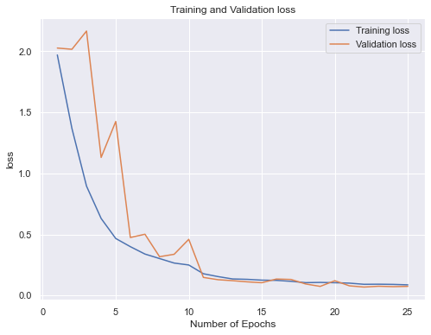
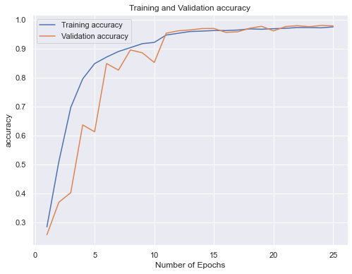
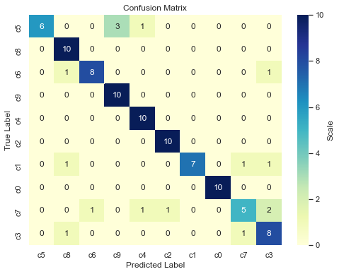
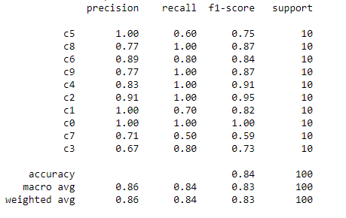
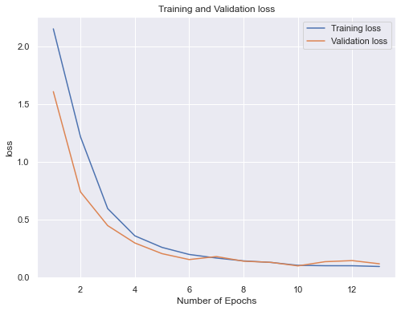
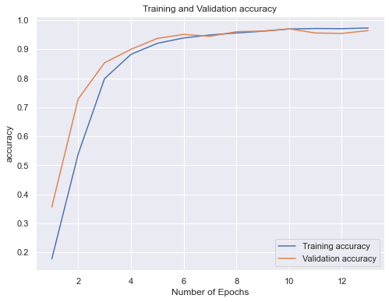
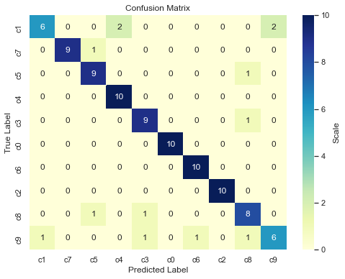
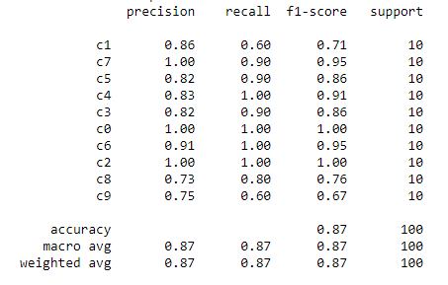
Project analysis slide 7
Model Evaluation
Convolution Neural Network from Scratch
Dropout 0.3, Batch Normalization, Data Augmentation, Learning Rate 0.01
Fine-tuned VGG-19 Convolution Neural Network
Dropout 0.3, Data Augmentation, Learning Rate 0.0001, Frozen Layers: 10

Slide 14
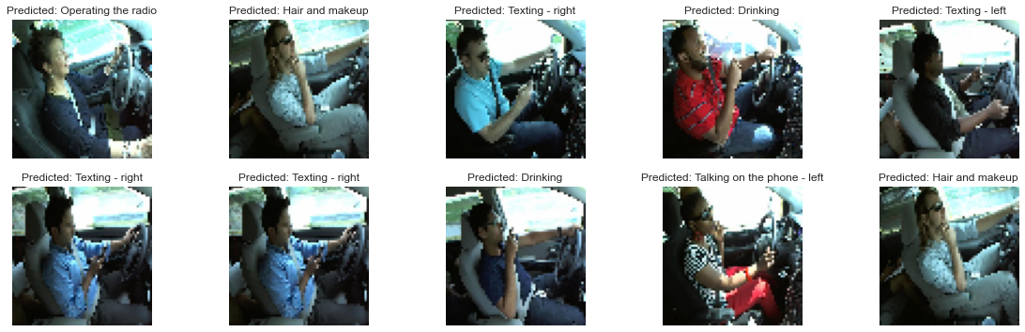
Project analysis slide 7
Conclusion & Lessons Learned
Do we have a Convolution Neural Network that can detect distracted driver?
Convolution Neural Network is an efficient approach for image classification problem.
Fine-tuned VGG-19 network outperforms the convolution neural network from scratch eventually with an accuracy of 87%.
Convnet from scratch always beats VGG-19 if conv base is not re-trained. (training time is much less)
Image Data Augmentation, Batch Normalization and Dropout can be used to minimize the impact of overfitting.
What I have learned?
Mistakenly used horizontal flip for image augmentation with ImageDataGenerator leads to worse performance
The shuffle needs to be set to False when generating confusion matrix while using ImageDataGenerator.
Fine-tuning a pre-trained network without re-train the convnet base does not guarantee good result for image classification that has complex input.
Dropout rate does not show liner impact on the network performance.
Learning rate needs to be set accordingly by experiments, there is no BEST rate for all networks.

Slide 15
Project analysis slide 10
Future Work
Image Augmentation with Deep Learning Approach
Adversarial training
Training Platform
Bridges-2 system at Pittsburgh Supercomputing Center (PSC)
Neural style transfer
GAN (Generative adversarial networks) data augmentation
Model Deployment
Integration with cameras for Real-time detection

Slide 16
Project analysis slide 10
Reference
[1] Danger – Distracted Driving! https://dekalbcountyonline.com/danger-distracted-driving/
[2] Centers Disease Control and Prevention (CDC) Transportation Safety. Distracted Driving. https://www.cdc.gov/transportationsafety/Distracted_Driving/index.html
[3] State Farm Distracted Driver Detection. https://www.kaggle.com/c/state-farm-distracted-driver-detection/data
[4] National Highway Traffic Safety Administration. (April 2020) Traffic Safety Facts Research Note: Distracted Driving 2018external icon. Department of Transportation, Washington, DC: NHTSA. Accessed 18 August 2020.
[5] “Deep Learning for Computer Vision.” Deep Learning with Python, by Chollet François, Manning Publications Co., 2018.
[6] Shorten, C., & Khoshgoftaar, T. M. (2019). A survey on Image Data Augmentation for Deep Learning. Journal of Big Data, 6(1). https://doi.org/10.1186/s40537-019-0197-0
[7] Image data preprocessing. Keras. https://keras.io/api/preprocessing/image/
[8] Towns, J., Cockerill, T., Dahan, M., Foster, I., Gaither, K., Grimshaw, A., Hazlewood, V., Lathrop, S., Lifka, D., Peterson, G.D., Roskies, R., Scott, J.R. and Wilkens-Diehr, N. 2014. XSEDE: Accelerating Scientific Discovery. Computing in Science & Engineering. 16(5):62-74. http://doi.ieeecomputersociety.org/10.1109/MCSE.2014.80.
[9] Nystrom, N. A., Levine, M. J., Roskies, R. Z., and Scott, J. R. 2015. Bridges: A Uniquely Flexible HPC Resource for New Communities and Data Analytics. In Proceedings of the 2015 Annual Conference on Extreme Science and Engineering Discovery Environment (St. Louis, MO, July 26-30, 2015).

Slide 17
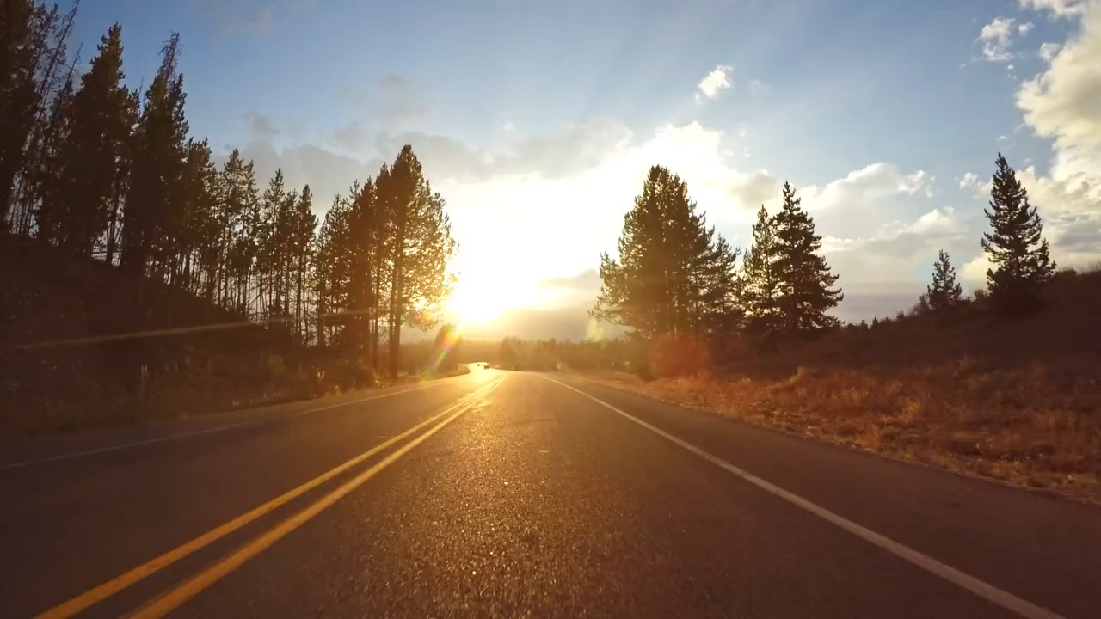

Slide 18
Q & A

Slide 19
Thank You !

